Slide 1
263F Project
Shixuan Sun, Xiaoyang Zhao
Notes:
Quick self intro

Slide 2
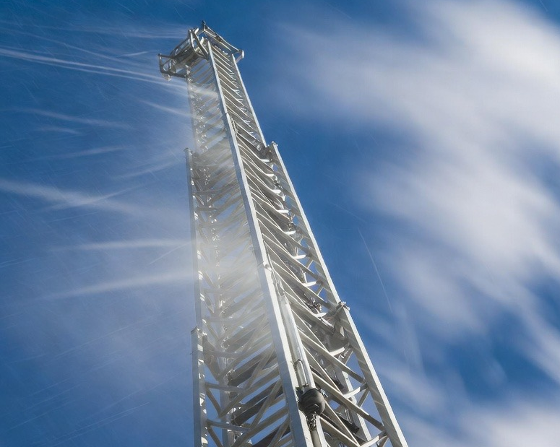
Project Overview
This project aims to investigate wind-induced vibration of the aerial ladder
Formulation of a simplified aerial ladder model
Represent wind gusts with various Reynolds numbers as distributed aerodynamic force
Compute the vibration response
Interpretation of results

Slide 3
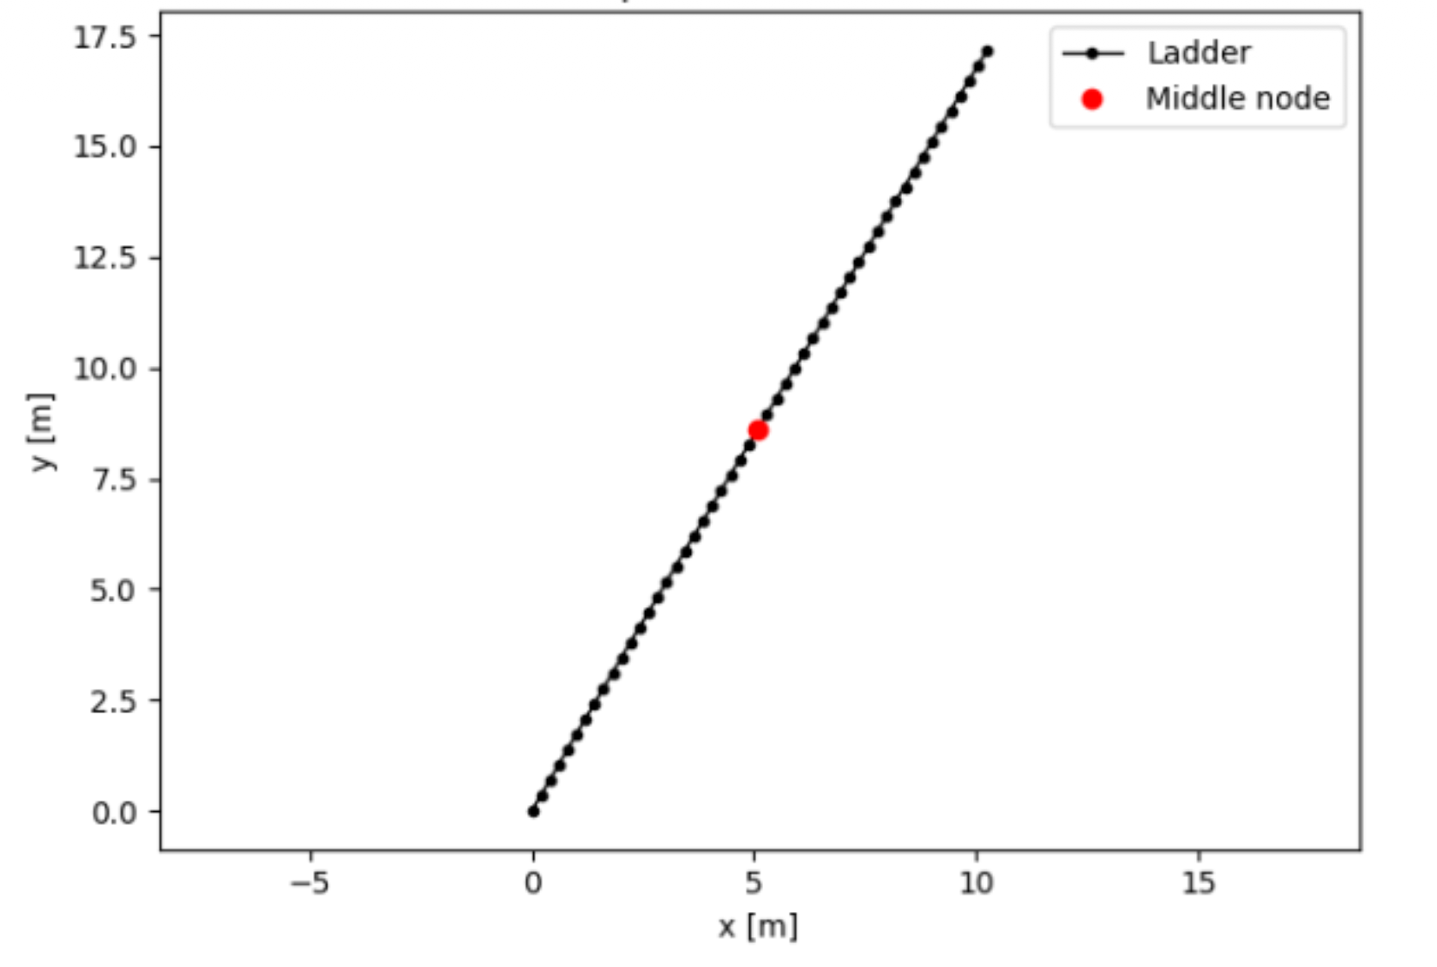
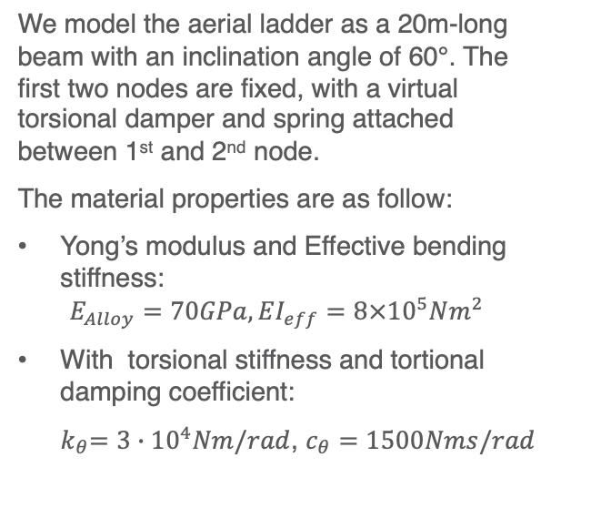
Formulation of simplified aerial ladder model
We model the aerial ladder as a 20m-long beam with an inclination angle of 60°. The first two nodes are fixed, with a virtual torsional damper and spring attached between 1st and 2nd node.
The material properties are as follow:
Yong’s modulus and Effective bending stiffness:
$$E_{Alloy}=70GPa, EI_{eff}=8×{10}^{5}Nm^{2}$$
With torsional stiffness and tortional damping coefficient:
${ k}_{θ}=3∙10^{4}Nm/rad$, $c_{θ}=1500Nms/rad$

Slide 4
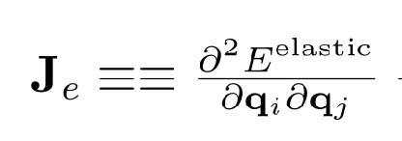
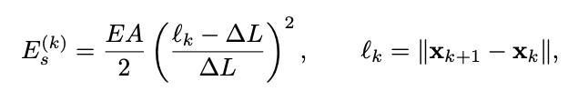
Force and Energies
$q_{new free}=q_{free}+∆q$, where $∆q= J_{free}\backslash f_{free}$

Slide 5
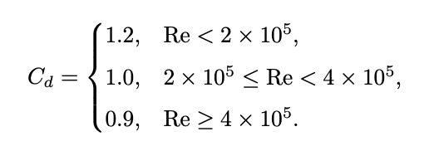
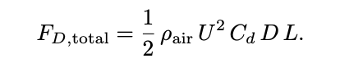
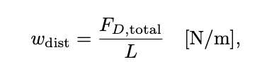
Wind Gust
The wind gusts are modeled as distributed forces acting on the projected frontal area of the ladder. Depending on the laminar or turbulent case of the wind. We introduce a pricewise drag coefficient :
Then the the total drag force becomes:
The distributed drag force then becomes:

Slide 6
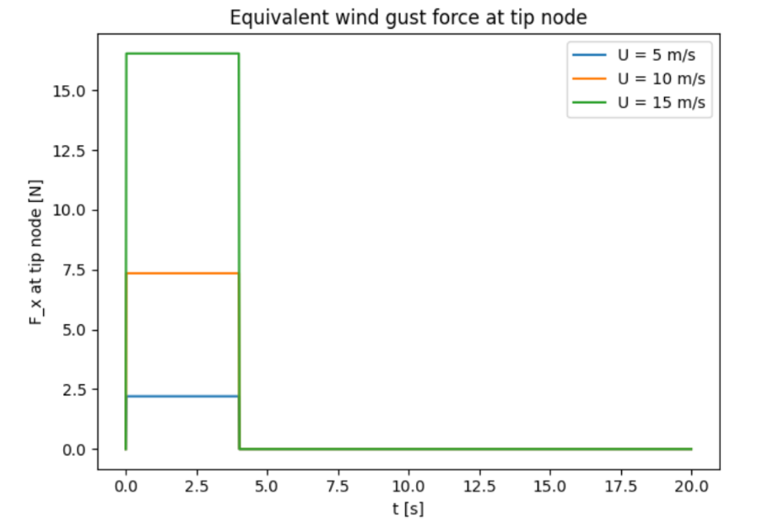
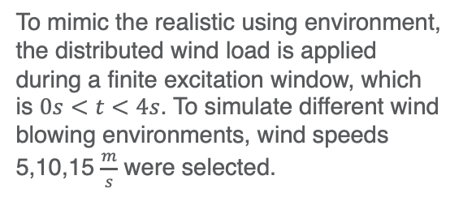
Wind Gust
To mimic the realistic using environment, the distributed wind load is applied during a finite excitation window, which is $0s<t<4s$. To simulate different wind blowing environments, wind speeds 5,10,15 $\frac{m}{s}$ were selected.

Slide 7
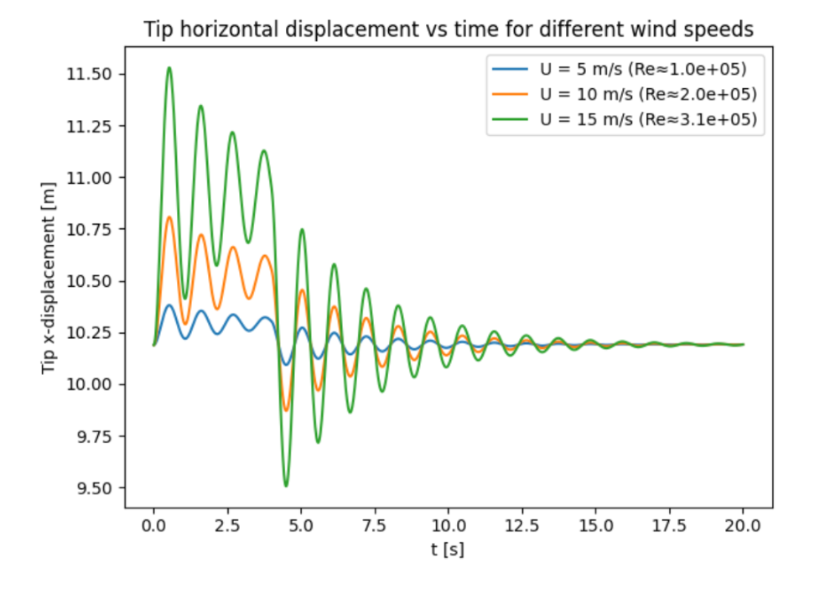
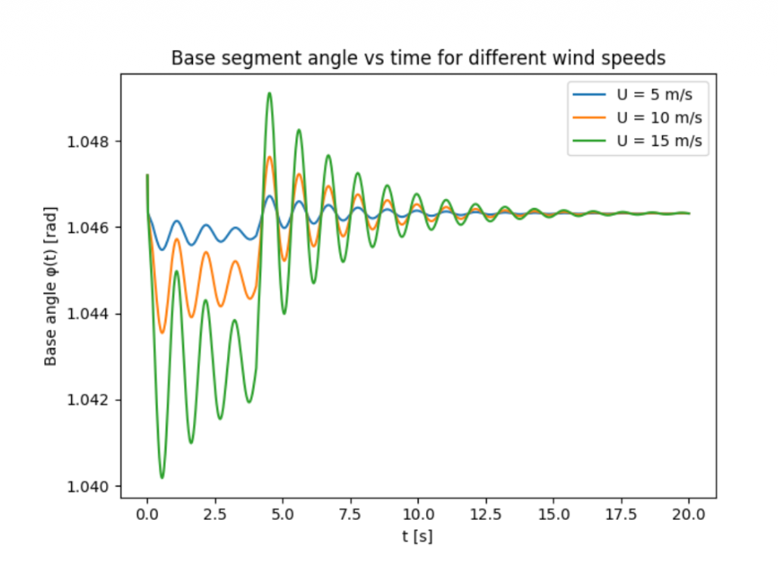
Results

